Slide 1
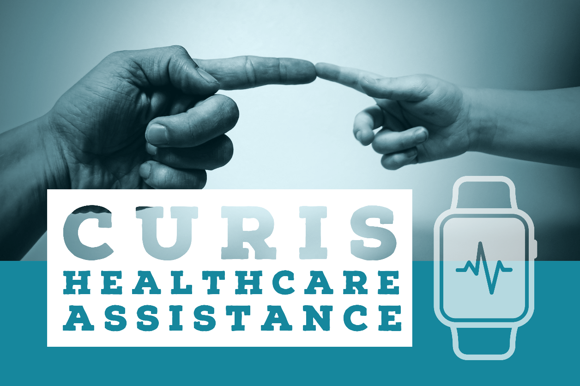

Slide 2

Introduction
Nowadays in our busy life we are unable to spend time with our elderly and take care of their needs.
But this is the time in their lives they need help in their day to day activities and require someone around to help them out.
So DEUS CEASIM came up with a device that can help monitor elderly and also notify when they are in danger or need our help.

Slide 3
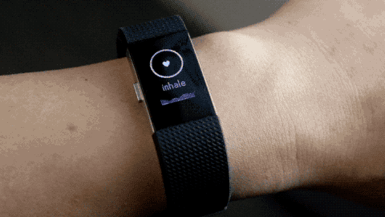
Aim
DUES CEASIM aims to build a smart wearable device for the elderly that can help them stay safe and healthy.
By helping them with their day to day activities and being a reliable companion.
We aim to achieve a friendly interface between elderly and technology that keeps them company in place of people.

Slide 4
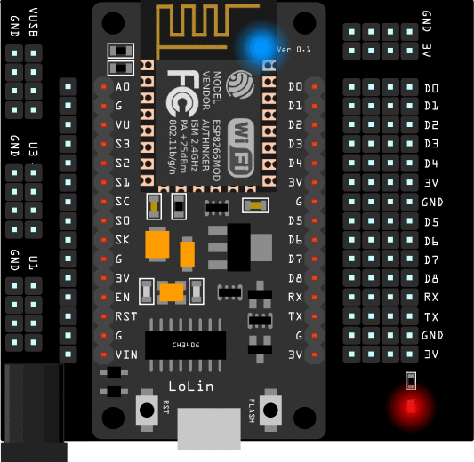
Components
Our wearable device would consist of the following:
A Micro-controller board to control all the
input and output devices.
2) Display, to display all the information.
3) Wifi module to connect the watch to the internet.
4) Button and a buzzer.

Slide 5
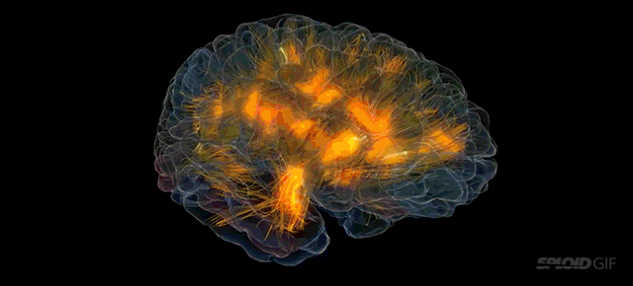
Target community
Surveys consistently show that 80 to 90 percent of seniors want to stay in their own home as they age. A number of technological solutions can make doing so safer for them. Any senior that lives alone should have a Personal Emergency Response System
According to the US Pew Internet research center, 77% of older people would need someone to help walk them through the process of setting up a new device.
DEUS CEASIM aims to target such elderly people who find technology tough to handle and help them reach a platform, enough to keep their needs met.

Slide 6
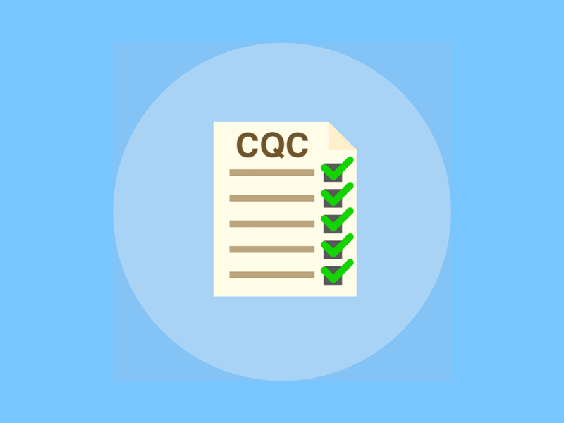
Features
The smart device includes the following features:
1) Alert the caretakers or close ones, if the elderly falls down suddenly or slips.
2) If the elderly is having some medical emergency he/she can immediately inform the close ones by pressing the panic button on the watch.
3) The watch will also remind the elderly to take medicines on time.

Slide 7
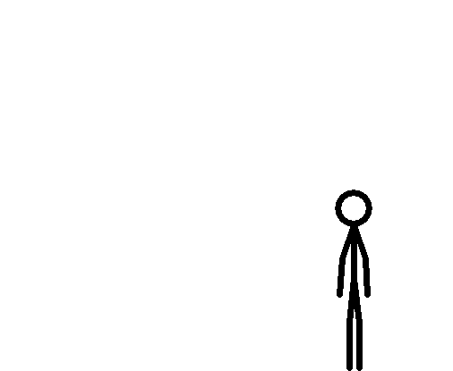
Fall detection
This feature is achieved by using a MPU6050 sensor which is a combination of both accelerometer and a gyroscope.
We measure the values of the accelerometer along the x , y and z axis and put
it in a equation with a threshold
limit. When the limit is crossed
an alarm is triggered and a
notification is sent.

Slide 8

Panic button
This is one of the most unique feature of CURIS, where close ones can be alerted in case of emergency.
This feature is achieved by using MQTT protocol, the signal from the device
is sent to Adafruit server which is
monitored by an API that is created
on the IFTTT platform.
Once the API is triggered the designated user receives a push
notification on his mobile.

Slide 9
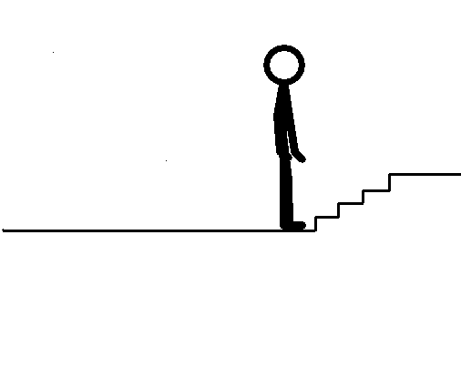
Daily reminders
Using the IFTTT platform, we are using API to set reminder at a particular day and time.
So on the particular day and time the API sends remainder to the device, which can be seen as a Led output.
We can customize our applets to send various reminders depending on the person using the device.
This way CURIS becomes a
personalized healthcare device.

Slide 10

Future Possibilities
With proper funding and a little guidance we can
Add a display feature for time and weather,
Live location of the elderly,
Analyze irregular heartbeats and blood pressure.
Link the watch with personal assistants such as Alexa or google assistant for better user interface experience.

Slide 11

Uniqueness
The device is directly connected to the internet unlike other commercially available products.
This device is specially designed to meet the needs of the elderly and for their well being.
The panic button feature is simple yet effective function available in this device which cannot be found elsewhere.

Slide 12

Conclusion
From the results of the present study, it is evident that the use of new technologies by the elderly population significantly contributes to a better quality of life, improving parameters of daily living such as transportation facilitation, communication and participation in social life. Further, it offers the link of elderly to services that meet their immediate needs, and in particular the cooperation and coordination with the network of Primary Care and Social Protection.
This work is of low cost, very effective, and productive. But there is always room for improvement.
This merchandise has been designed as a prototype and requires further developments for using it in assorted applications.

Slide 13

KAVISH MEHTA
RITWIK SARASWAT
R. AKSHITH

